Slide 1
Final Presentation
Argos Inc
RoeMello Holliday, Austin Killough, Chandler Neece, Chavis Sanchez

Slide 2
NutriBuddy
Web app designed to make healthy eating easier.
Free calorie counting app that allows the user to search foods and add them to their daily calories while keeping track of meals.
An integrated AI assistant that provides suggestions and recommendations based on user’s questions.

Slide 3
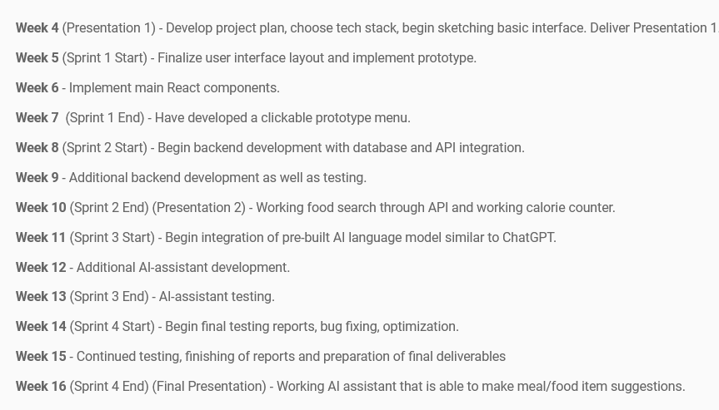
Final Timeline

Slide 4
Final Timeline
Week 15 - Implement macro goal tracking, continued testing, finishing of reports and preparation of final deliverables.
Week 16 (Sprint 4 End) (Final Presentation) - Working macronutrient tracking. Final testing before delivery.
We were able to make all of the deadlines that we set at the beginning of the semester.

Slide 5
Results
We implemented 5/5 features featured on our initial technical document.
These features include:
Use Case 1: User Authentication
Use Case 2: Track Daily Caloric Intake
Use Case 3: Access Nutritional Information / Macros
Use Case 4: Log Food
Use Case 5: Interact with AI Chatbot
We did not have any major components left to be completed.

Slide 6
Functionality Evaluation
Most of the functionality of this app was manually tested.
Tests abided by the user stories put in place during the original planning.
Testing was done at the end of each sprint to make sure that the user stories were being followed.
No major bugs were ran into during the development, just minor issues implementing APIs at first.

Slide 7
Security Evaluation
NutriBuddy has employed several security methods and tools to ensure the safety and integrity of user data
We implemented token-based authentication mechanisms to securely authenticate and authorize API requests.
Trained the AI the only respond to Nutritional information only
How we store health data is a work in progress with how we continue to secure NutriBuddy

Slide 8
Work to be Done
There is not much substantial work to be done. The primary features we desired to include are added.
A secondary feature that we would have liked to add would be macronutrient tracking/counting inside the food logs. You can see the macros when you look up a food, but we did not add the ability to track them.
Some minor things could be tweaked such as the UI, but are optional.

Slide 9
Demo Setup
To perform the demo, we recorded a video stepping through the features of the locally hosted web application.
We create a new account and walk through just like a new user would experience the application.

Slide 10
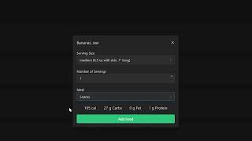
Demo

Slide 11
Summary
All in all, the demo captures 5/5 use cases and the primary two we wanted to complete: food logging and in-app AI chatbot conversating.
While there is room to add features we would like to have such as macronutrient counting and smoother UI improvements, we’re satisfied with what we were able to show in this demo.

Slide 12
Thank you

